Slide 1
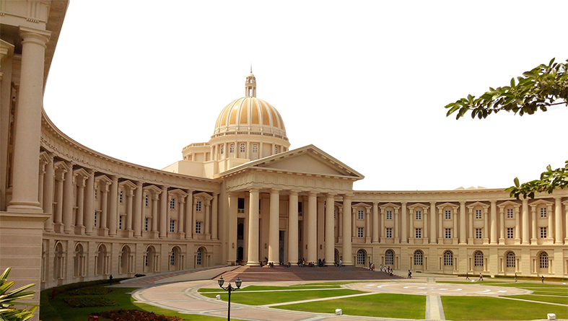
INFOSYS CAMPUS RECRUITMENT
Preparatory Guidance

Slide 2
INFOSYS ONLINE TEST
TEST FORMAT
Test usually contains 3 questions that will have to be attempted in 3 hours
Test will have a sectional cut-off as well as a total cut-off
Each question will belong to different difficulty level:
Easy – Simple questions that can be solved by basic application of aptitude, algorithm and data structures
Medium – Usually a question based on Greedy algorithm
Hard – Usually a question based on Dynamic Programming
Code can be written for each question using one of the programming language from C/C++/Java/Python/JavaScript
Notes:
Recruiter can talk about each step of the process in detail

Slide 3
INFOSYS ONLINE TEST – HOW TO PREPARE
DIFFICULTY OF QUESTION - MEDIUM
A Greedy algorithm is any algorithm that follows the problem-solving heuristic of making the locally optimal choice at each stage
Types of Greedy algorithm:
Pure greedy algorithms
Orthogonal greedy algorithms
Relaxed greedy algorithms
Notes:
Recruiter can talk about each step of the process in detail

Slide 4
INFOSYS ONLINE TEST – HOW TO PREPARE
DIFFICULTY OF QUESTION - HARD
Dynamic Programming (DP) is an algorithmic technique for solving an optimization problem by breaking it down into simpler subproblems and utilizing the fact that the optimal solution to the overall problem depends upon the optimal solution to its subproblems.
Principles of Dynamic Programming:
Breaking the problem down into subproblems and calculating their values. Next time, upon encountering the same subproblem, the value can be reused instead of recalculation
Avoid repeated work by remembering partial results, a common approach for performance enhancement
Notes:
Recruiter can talk about each step of the process in detail

Slide 5
INFOSYS ONLINE TEST – HOW TO PREPARE
DIFFICULTY OF QUESTION - HARD
Characteristics of a Dynamic Programming problem
Following are the two main properties of a problem that suggest the given problem can be solved using Dynamic Programming:
Overlapping subproblems
A problem has overlapping sub-problems if its solution involves solving the same subproblem multiple times.
Optimal substructure properties
The overall optimal solution can be constructed from the optimal solutions of its subproblems.
Notes:
Recruiter can talk about each step of the process in detail

Slide 6
INFOSYS ONLINE TEST – HOW TO PREPARE
DIFFICULTY OF QUESTION - HARD
Dynamic Programming methods
There are two different ways to store values for an overlapping subproblem so that the values can be reused:
Top-down with Memorization
To solve a bigger problem, in this approach we recursively find the solution to the smaller sub-problems and its result is cached. So next time the same sub-problem is tried to solve, the cached memorized result is returned.
Bottom-up with Tabulation
In this approach, we solve the problem “bottoms-up” i.e., by filling up an
n-dimensional table. Based on the results in the table, the solution to the top/original problem is then computed.
Notes:
Recruiter can talk about each step of the process in detail

Slide 7
INFOSYS ONLINE TEST – HOW TO PREPARE
DIFFICULTY OF QUESTION - HARD
Some examples of Dynamic Programming
Knapsack problem
Fibonacci Numbers
Palindromic Subsequence
Longest Common Substring
Dijkstra's algorithm
Notes:
Recruiter can talk about each step of the process in detail

Slide 8
INFOSYS VIRTUAL INTERVIEW
This round will access your technical and behavioral skills.
STRUCTURE
Total duration of the interview will be around 1 hour
You might be asked to solve a puzzle/problem using programming language of your choice
Students from CS/IT branch might be tested on: Algorithms, Data structures, Automata theory, Compiler, Computer Network, Computer Organization, Operating Systems, Digital Signal Processing and Object-oriented programming
Students from other branches might be tested on: Algorithms, Data structures, Computer Network, Digital Electronics, Digital Signal Processing, Mathematics, Object-oriented programming and Control system
Notes:
Recruiter can talk about each step of the process in detail

Slide 9
THANK YOU
Notes:
Thank you.

